Slide 1
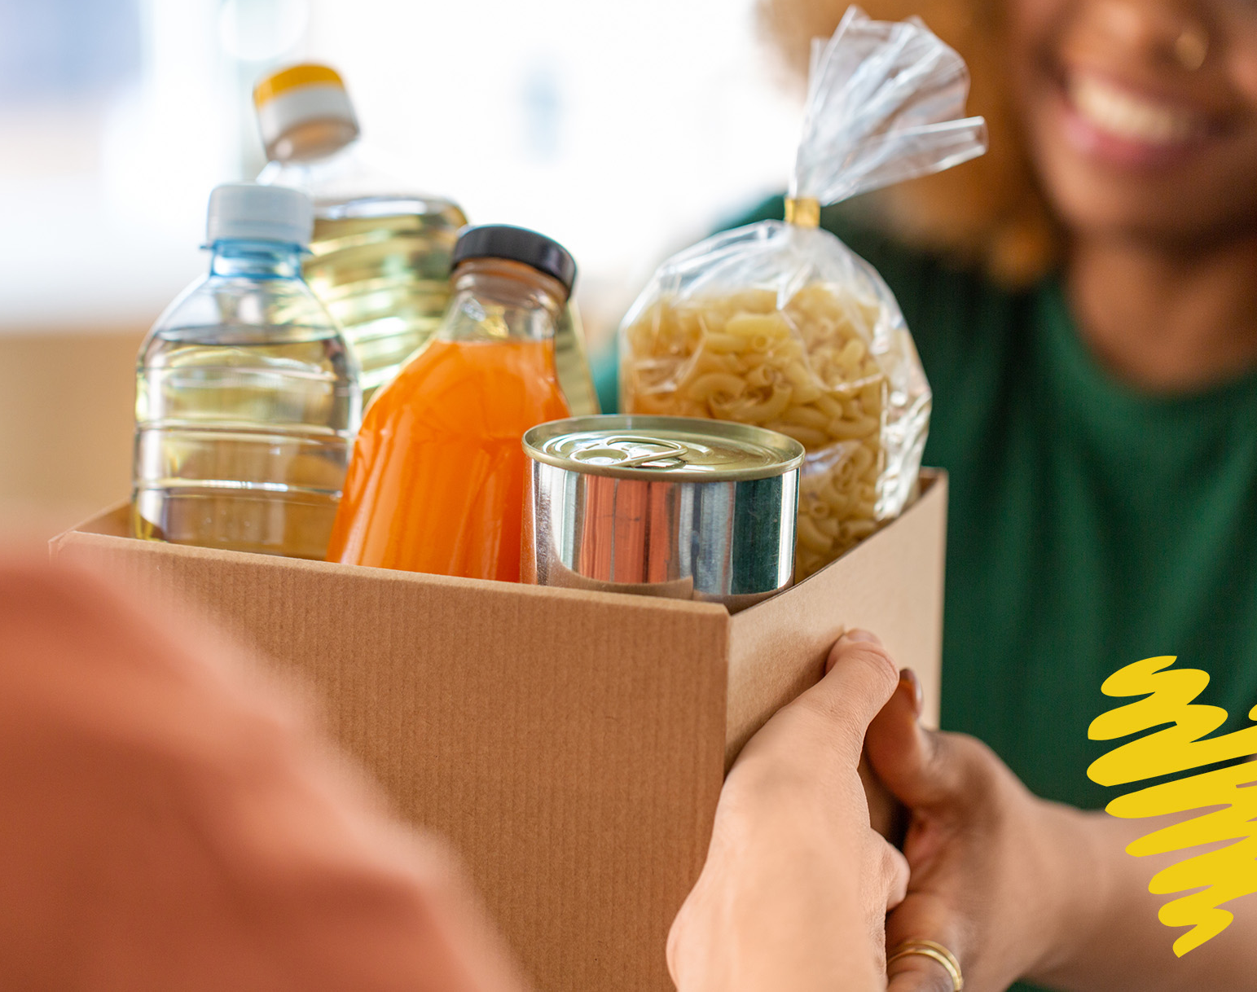

No Starvation
Professor :Jānis Amoliņš
Software development technology
Vasif Mammadov 201ADB053​ Nour Abed 220ADB232​

Slide 2

Our slogan
if you cannot feed hundred people just feed one

Slide 3
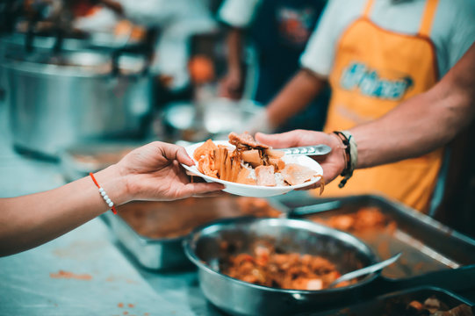
Software description
Our software Idea leads to no starvation As we see the poverty level is increasing nowadays in the whole world let’s take the example in latvia because we are living here . All the day we find people who ask for money to eat and at the same time we find restaurents like macdonals , KFC ,…. Throw the rest of good food , good burgers , pizzazs , donuts …. they throw all of that in the end of the day . I noticed too a big problem in latvia : the majority of expiration dates of food in the supermarkets are very close and 30% or even more of that food expire and they throw it. Why we don’t offer that good food from restaurent to those poor people intead of throwing it . Or for these supermarkets like Maxima and Rimi why they don’t use Automated tracking & monitoring of expiration dates and they donate this food before the expiration to these pepole .

Slide 4
The software can be an application where restaurents can add the number of food that they can donate in the end of the day , The supermarkets too can do their calculation and they can add in the application the type of food that they can offer it in the end of the day. They can be two side in the application the donator “ the one that will donate food” the volunteer “the ones that will deliver this food to poor people” >> like bolt volunteers, some charity clubs ….
Like this we will not stop poverty but at least we stop starvation

Slide 5
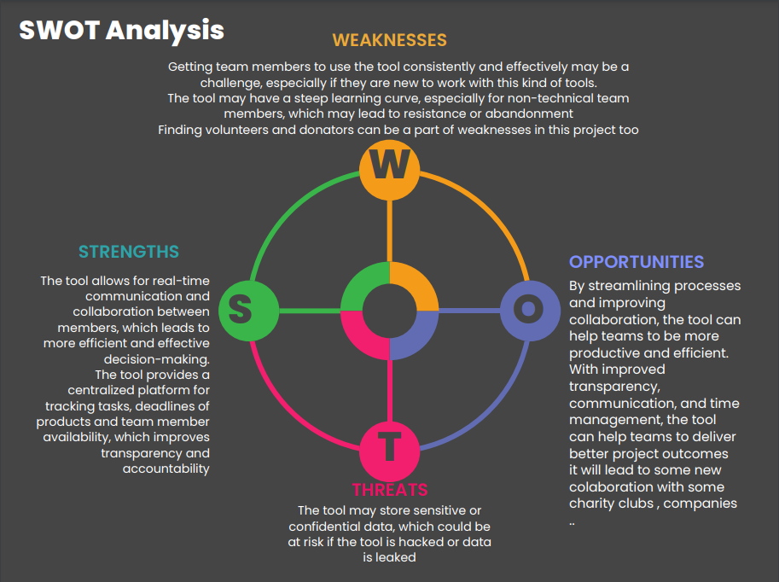

Slide 6
Thanks for your attention !

